Slide 1
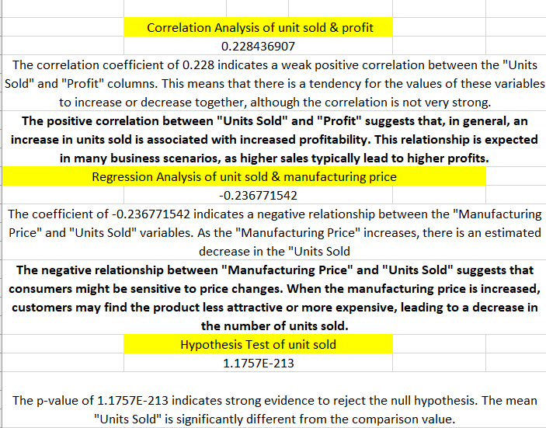
Strategic analysis

Slide 2
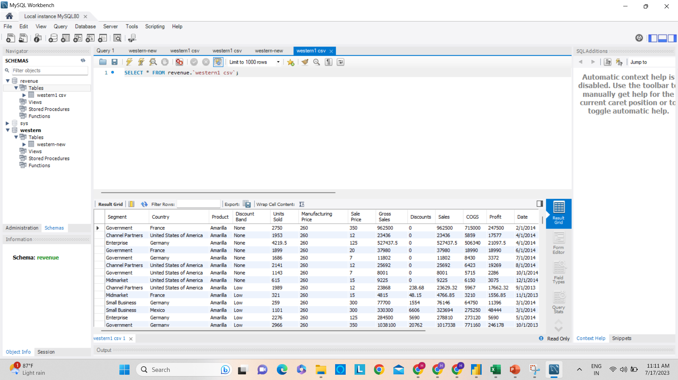

Slide 3
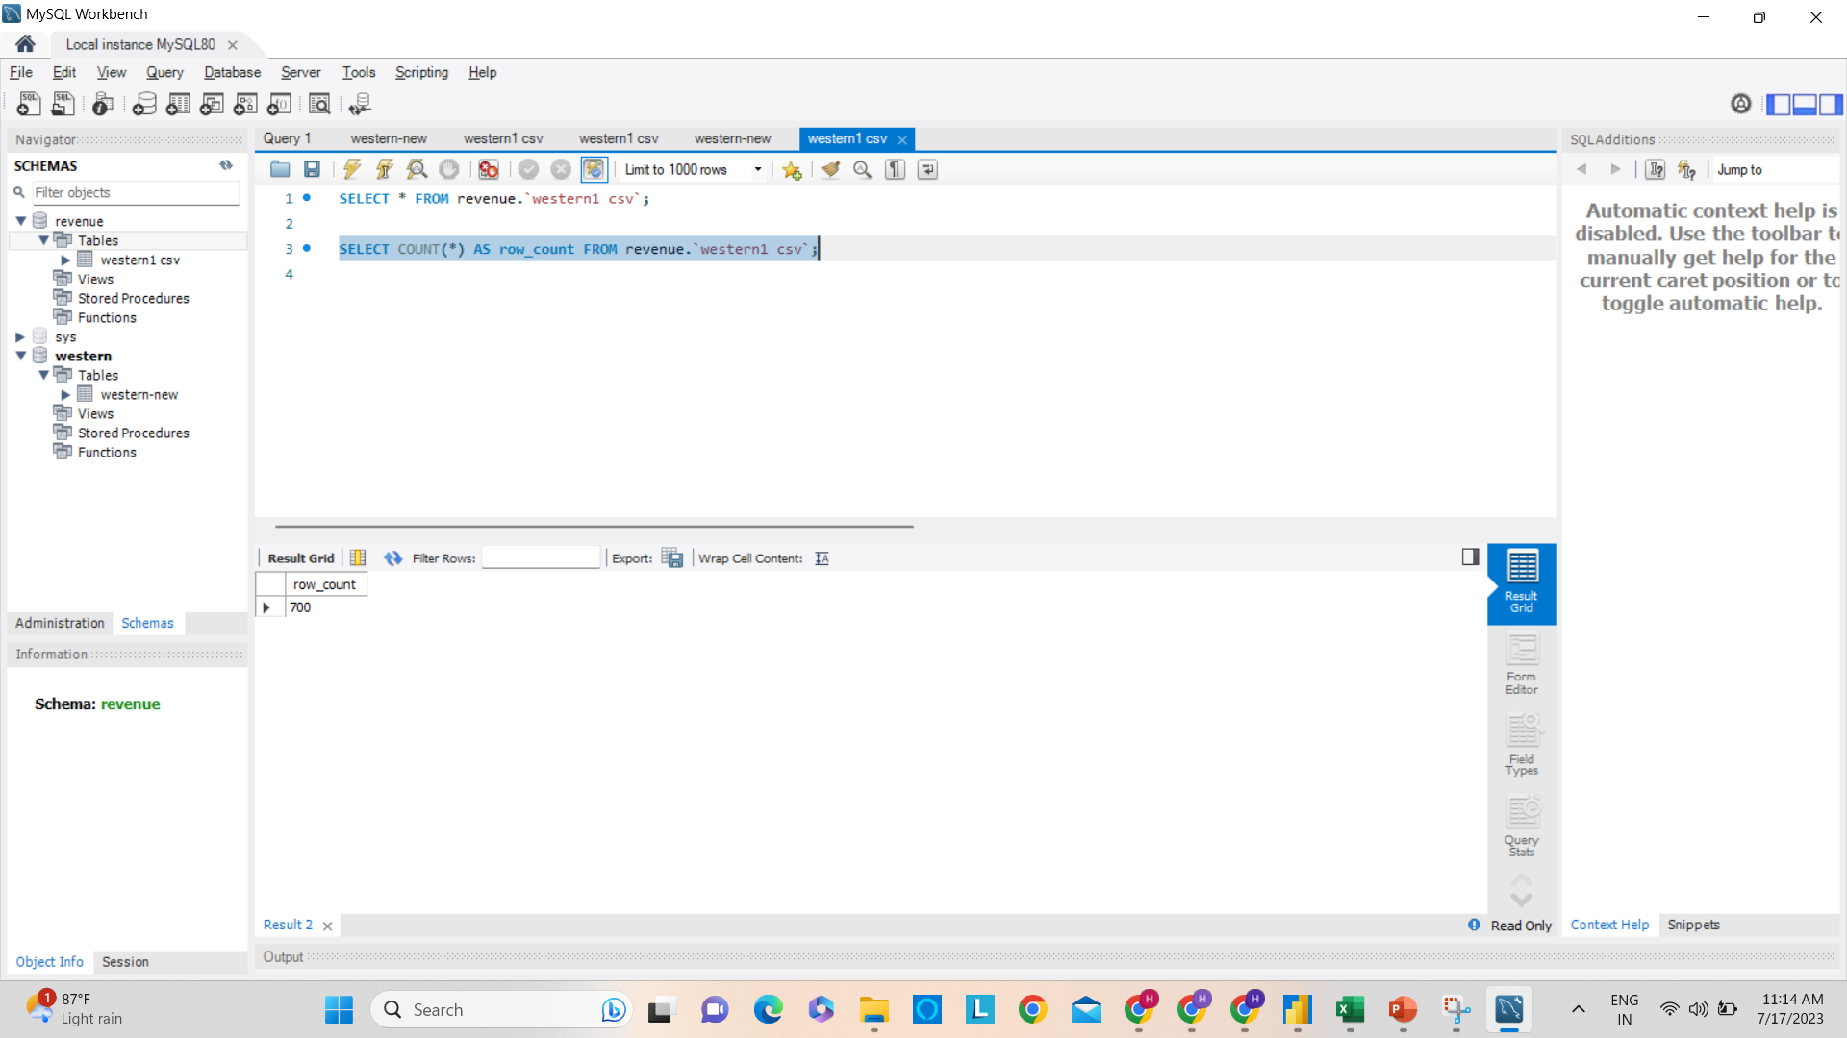

Slide 4
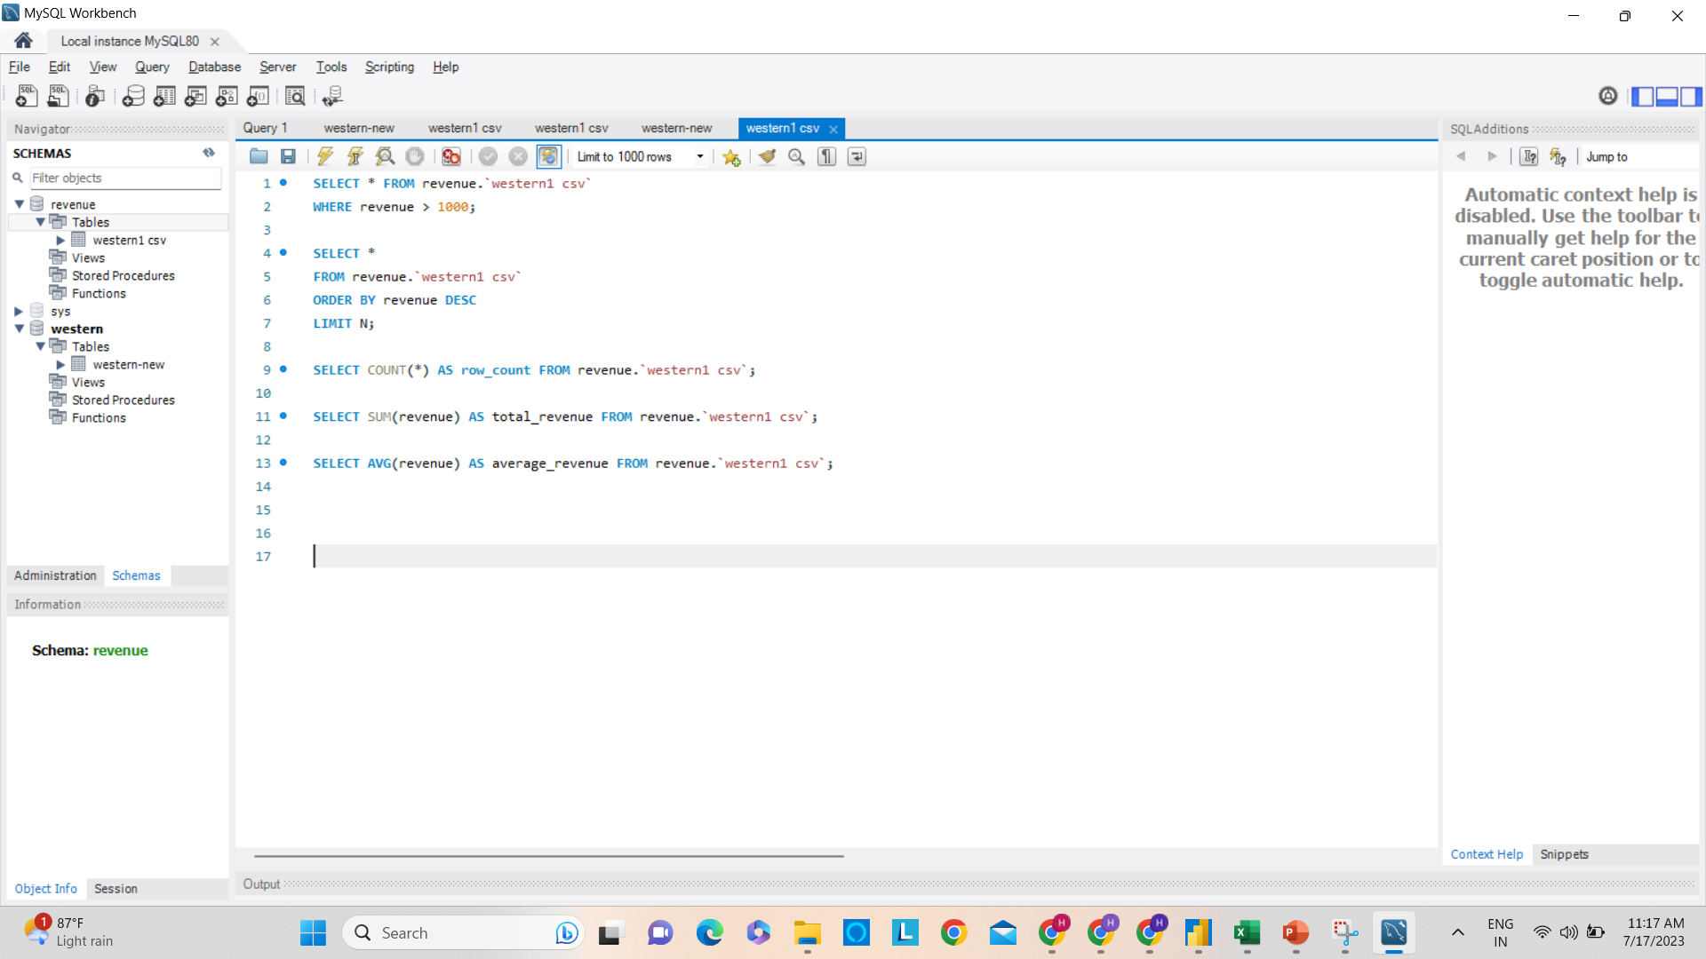

Slide 5
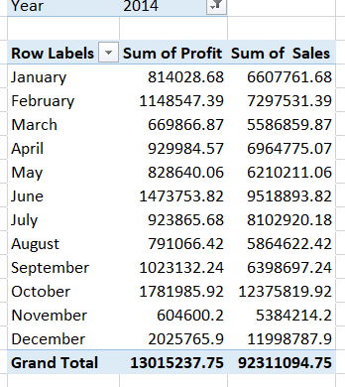
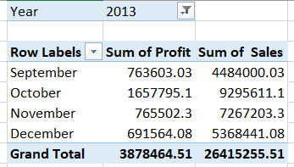
Show Yearly Profit
Bottom 3 product Carretera Montana Amarilla
Product wise Discount Paseo :- 2.60 M Velo :- 1.58 M VTT :- 1.46 M Amarilla :- 1.29 M Montana :- 1.16 M Carretera :- 1.12 M
No. of Unit Sold each year 2013 :- 264.67 K 2014 :- 1.13 M
What are the product-wise sales? Paseo:- 33.01 M VTT :- 20.51 M Velo:- 18.25 M Amarilla:- 17.75 M Montana:- 15.39 M Carretera:- 113.28 M
Segment wise Profit Government :- 11.39 M Small business :- 4.14 M Channel Partner :- 1.32 M Midmarket :- 660.10 K Enterprise :- -614.55 K
Yearly Sales 2013 :- 26.42 M 2014 :- 92.31 M
Show sales by Country USA :- 25.03 M Canada :- 24.89 M France :- 24.35 M Germany :- 23.51 M Mexico :- 20.95 M

Slide 6
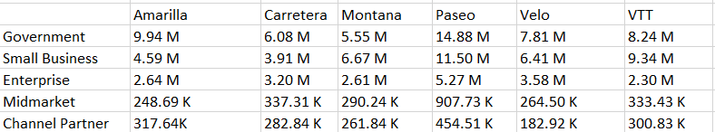
Segment wise Product Sale

Slide 7
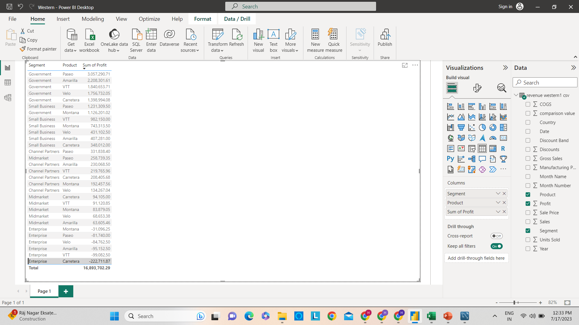
Segment-wise product-wise profit.

